Slide 1

Weather website
NAME:THATHA.ARCHANA BHAVANI
Subtitle: live weather updates at your finertips
ORGANISATION:MICRO IT
TOPIC:Weather website

Slide 2
Introduction:
What is weather website?
A weather website is a place on the internet where you can check:
If it’s sunny, rainy, or cloudy
The temperature (how hot or cold it is)
If it will rain or snow soon
The wind and humidity
Here are some easy-to-use weather websites:
weather.com – Shows weather in your city.
accuweather.com – Gives daily and weekly forecasts.
windy.com – Has moving maps with wind and rain.
weather.gov – For weather in the U.S.
Why did you choose to create it?
I didn’t create the weather website myself, but I can explain why people create weather websites:
People and organizations create weather websites to:
Help others plan – So people know if they should carry an umbrella, wear a jacket, or stay safe from storms.
Warn about danger – Like strong storms, hurricanes, or floods.
Support jobs – Farmers, pilots, sailors, and many others need weather info every day.
Share science – Weather websites use data from satellites and weather stations to show how the Earth’s climate works.
If you're asking why I chose those websites, it's because they are:
Easy to use
Very popular
Known for giving correct and updated information

Slide 3
Radar maps (rain, storms)
News and weather videos
Severe weather alerts
🌧️ AccuWeather
Minute-by-minute rain forecast ("MinuteCast")
Hourly, daily, and 15-day forecasts
Air quality and allergy updates
Radar and satellite maps
🌪️ Weather.gov (National Weather Service – USA)
Official warnings and alerts
Detailed forecast with wind, humidity, etc.
Radar and storm tracking
Good for emergencies and safety info
🌬️ Windy.com
Live wind and weather maps
Interactive maps with layers (rain, clouds, waves)
Great for travelers, pilots, and outdoor sports
Very visual and detailed

Slide 4

ABSTRACT
This provides the structure and functionality for a basic weather application. The web app allows users to enter a city name and retrieve the current weather information using the OpenWeatherMap API. It consists of three main components:
HTML (Structure): The HTML defines the layout of the weather app, including a header, an input field for entering the city name, a button to trigger the weather fetch operation, and a div to display the results.
JavaScript (Logic): The JavaScript code handles the logic of fetching weather data from the OpenWeatherMap API. It sends a request to the API when the user clicks the "Get Weather" button, processes the JSON response, and displays relevant weather information such as the city name, temperature, weather description, humidity, and wind speed. If the city is not found or there is an error in fetching data, appropriate error messages are displayed.
CSS (Styling): The CSS provides a clean and user-friendly design. It centers the app on the screen, gives the container a card-like appearance with padding and rounded corners, and ensures the input and button are visually appealing. It also adds a simple box-shadow for a subtle elevation effect.
The app uses a flexible layout and makes asynchronous requests to ensure smooth, real-time interactions with the user. The overall goal of this web application is to offer users easy access to real-time weather data for any city, displayed in a simple, clean interface.

Slide 5
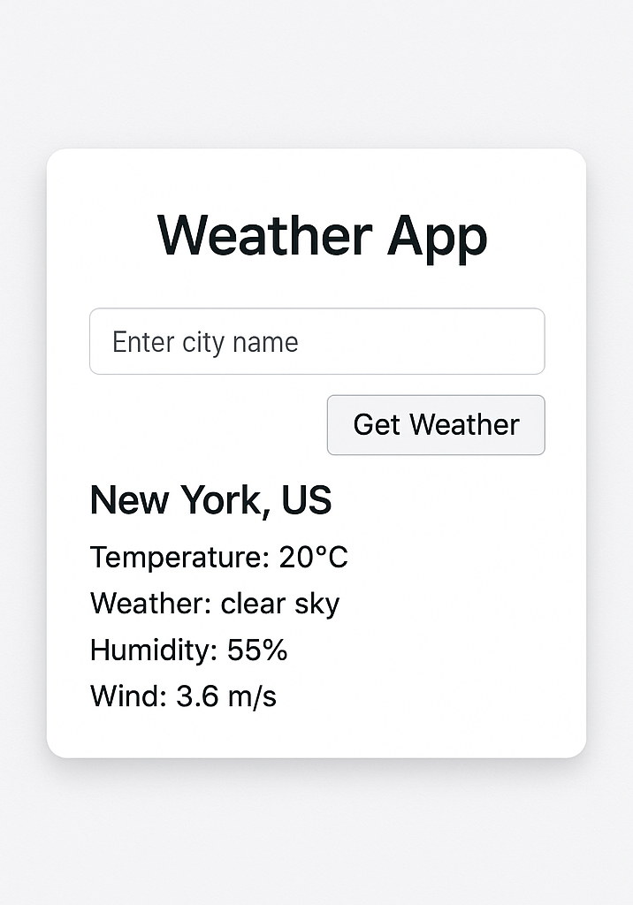
Objective of the project
The primary objective of this Weather App is to allow users to quickly and easily check real-time weather information for any city of their choice. By leveraging the OpenWeatherMap API, the app retrieves data such as the current temperature, weather conditions, humidity, and wind speed for the specified city and presents this information in a user-friendly format.
Specific Objectives:
User Input:
Provide an intuitive interface where users can input a city name.
API Integration:
Fetch weather data from the OpenWeatherMap API based on the user’s input.
Real-Time Weather Data Display:
Display real-time weather information such as temperature (in Celsius), weather description, humidity, and wind speed.
Error Handling:
Show appropriate messages in case of errors, such as invalid city names or issues with the API request, ensuring that the user experience is smooth and error-free.
Responsive and Clean UI:
Ensure a simple and clean user interface that provides a smooth experience across devices, with modern CSS design and minimalistic elements.
Educational:
Demonstrate the use of external APIs, error handling, and asynchronous JavaScript in a practical, real-world application.

Slide 6
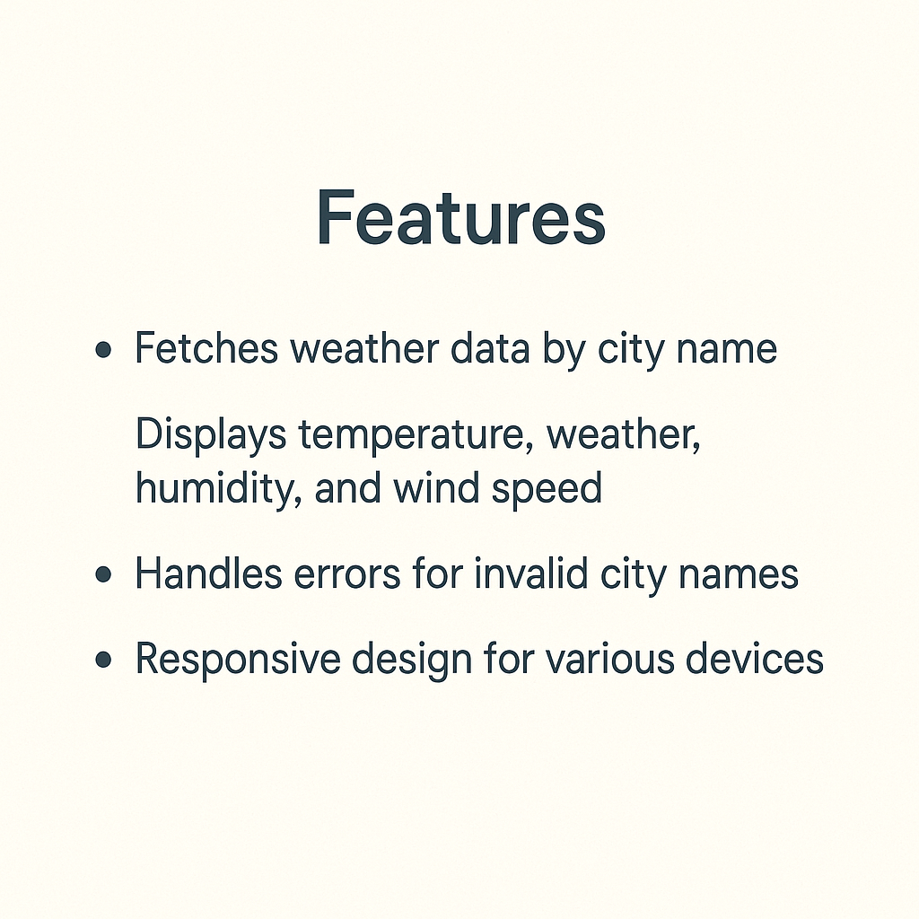
Features:
🌦️ Features of Your Weather Website
1. City-Based Weather Search
Users can enter any city name to get live weather data.
Easy-to-use input field and button for interaction.
2. Real-Time Weather Data
Fetches current weather information using the OpenWeatherMap API.
Displays temperature, weather conditions, humidity, and wind speed.
3. API Integration
Integrated with OpenWeatherMap API to provide live weather updates.
Utilizes asynchronous JavaScript (fetch + async/await) to handle API calls smoothly.
4. Dynamic Weather Display
After fetching the data, results are dynamically displayed without reloading the page.
Clean and readable layout using simple DOM manipulation.
5. Error Handling
If a city is not found or the API fails, it shows a user-friendly error message.
Ensures users are not left confused by missing data.
6. Responsive Design Basics
Styled with modern CSS: center-aligned layout, shadows, padding, and spacing.
Minimalist design makes it easy to use on different devices (can be improved further for full responsiveness).
7. Clean UI/UX
Simple and visually appealing user interface.
Easy-to-read text, soft color theme, and intuitive design for a pleasant experience
🌦️

Slide 7
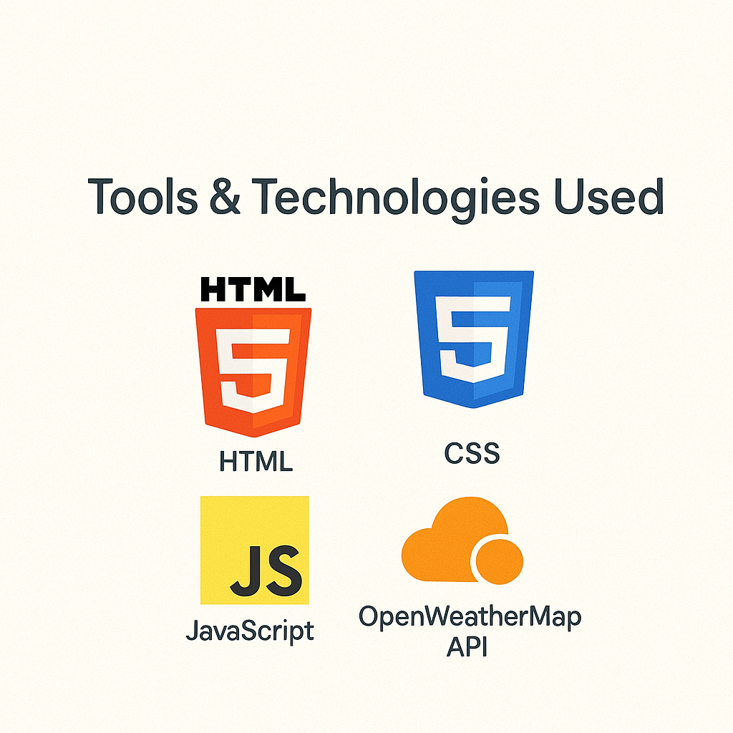
🛠️ Tools & Technologies Used
1. HTML (HyperText Markup Language)
Used to create the structure of the webpage
Elements include headings, input fields, buttons, and divs
2. CSS (Cascading Style Sheets)
Styles the webpage for a clean and modern look
Used for layout, colors, fonts, padding, and responsiveness
3. JavaScript (Vanilla JS)
Adds interactivity and logic
Handles the API request and updates the content dynamically
4. OpenWeatherMap API
Third-party API to fetch real-time weather data based on city name
Provides temperature, weather condition, humidity, wind speed, and more
5. Fetch API & Async/Await
Built-in browser feature to perform HTTP requests
Uses async/await for cleaner asynchronous code
6. DOM Manipulation
JavaScript is used to update the webpage dynamically with the fetched data
Changes the content of the weather result div without reloading the page
7. Web Browser (Client-side Execution)
Entire app runs on the client-side with no backend
Works directly in modern web browsers like Chrome, Firefox, or Edge

Slide 8
🧭 Website & Architecture Flow
1. User Interface (Frontend)
HTML + CSS + JavaScript
User enters city name in input field
Clicks “Get Weather” button
2. API Request (Client-Sides
3. API Response
OpenWeatherMap returns a JSON response with:
Temperature
Weather description
Humidity
Wind speed
Location (city, country)
JavaScript triggers the getWeather() function
Sends an HTTP GET request to OpenWeatherMap API using fetch()
API Endpoint

Slide 9
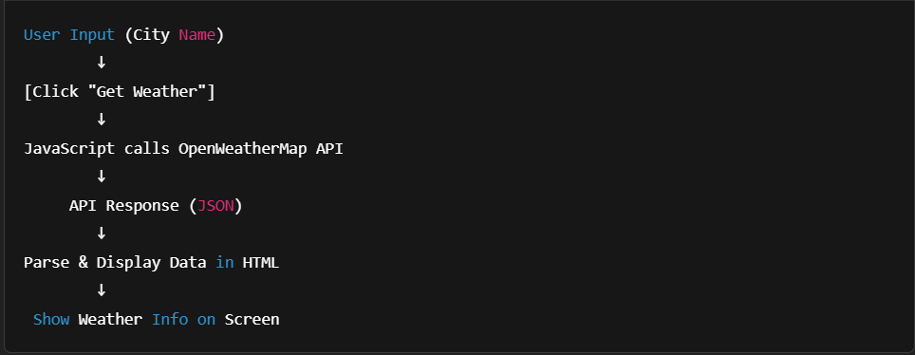
4. Display Weather
JavaScript parses the JSON response
Updates the DOM to display weather info in the #weatherResult div
5. Error Handling
If the API fails (e.g., wrong city name):
An error message is shown
The site doesn’t reload

Slide 10
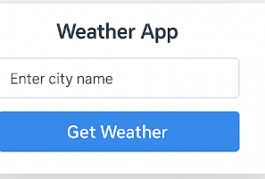
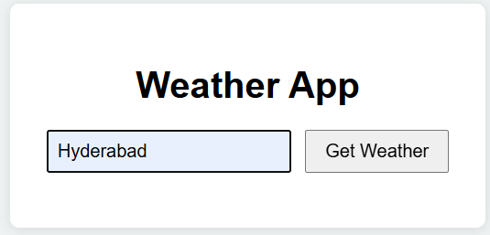
DEMO:
1.Homepage View (Initial State)
Shows the app title, input box, and "Get Weather" button.
2. Search Result Example (After Entering a City)

Slide 11
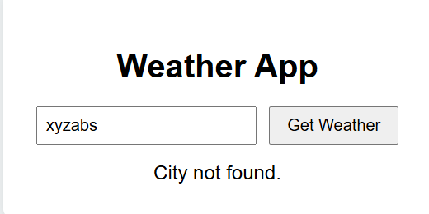
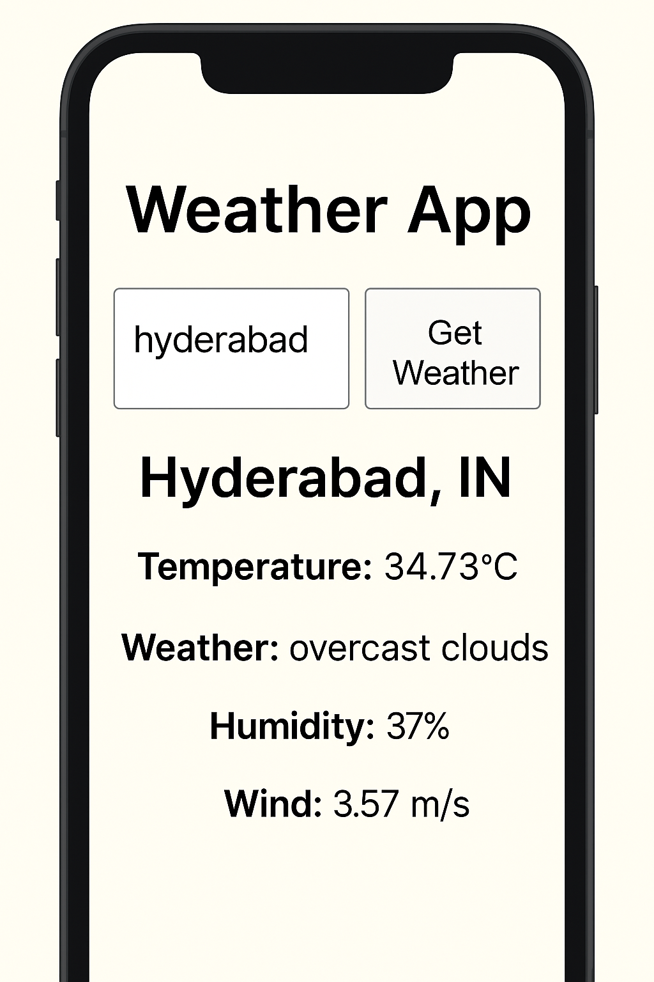
3. Error State Example
Try entering an invalid city (e.g., "Xyzabc") and take a screenshot showing the "City not found" message.
4. Responsive/Mobile View (Optional)

Slide 12
API Integration
🌐 API Integration - Weather App
What is API Integration? API (Application Programming Interface) integration allows your application to communicate with external services to fetch or send data.
🔗 Used API
OpenWeatherMap API
Provides real-time weather data such as temperature, humidity, wind speed, and description based on the city name entered by the user.
⚙️ How It Works
User enters a city name in the input box.
On clicking "Get Weather", JavaScript sends a GET request to the OpenWeatherMap API:
The API responds with JSON data containing weather details.
JavaScript parses the response and displays:
City and country
Temperature (°C)
Humidity (%)
Wind speed (m/s)
Weather description (e.g., cloudy, sunny)

Slide 13
🔮 Future Improvements
Add Hourly Forecasts Show temperature, precipitation, and wind predictions for each hour.
Include Radar or Map View Display interactive weather maps (clouds, rain, storms).
Add User Login for Saved Locations Allow users to save their favorite cities for quick access.
Multilingual Support Enable translation of UI and weather descriptions into different languages.

Slide 14
✅Conclusion
Summary of What Was Achieved Built a functional weather website that fetches real-time data using the OpenWeatherMap API and displays it in a user-friendly way.
Why This Site is Useful Helps users quickly check weather conditions for any city — useful for travel, planning, or daily activities.
Lessons Learned
How to integrate APIs using JavaScript
Importance of error handling and responsive design
Basics of UI/UX design and real-world application development

Slide 15
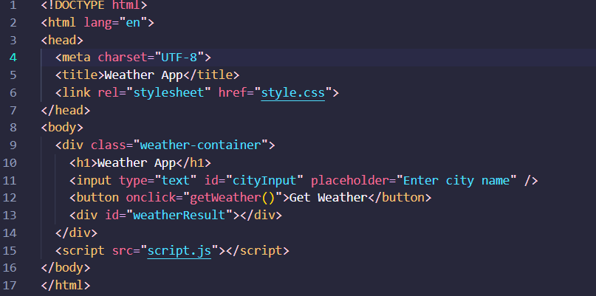
Code:
Index.html:

Slide 16
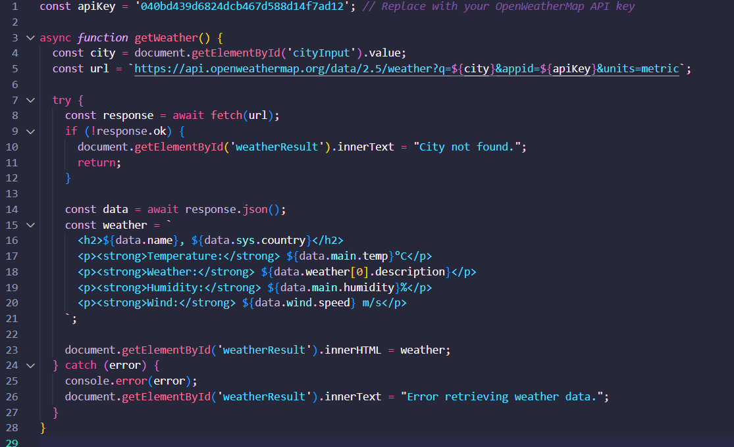
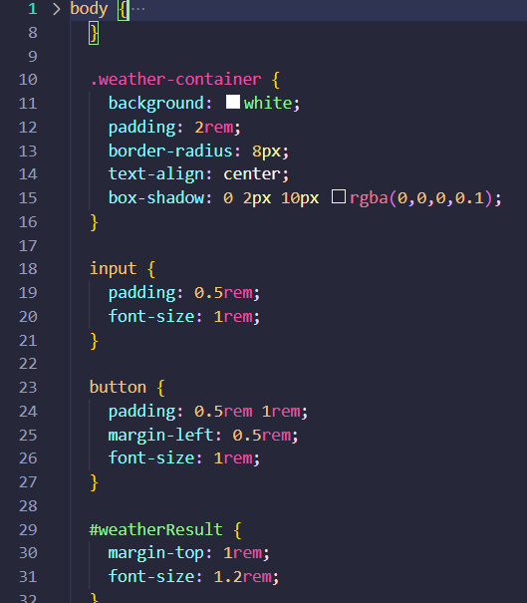
Script.js
Style.css

Slide 17
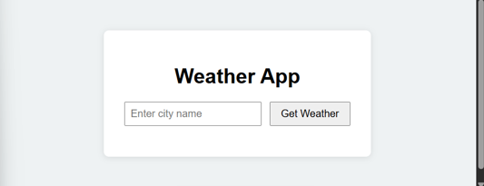
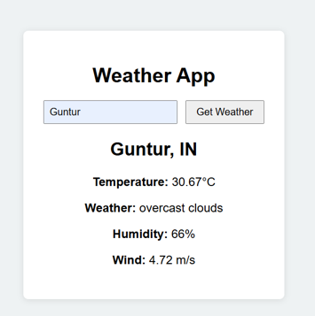
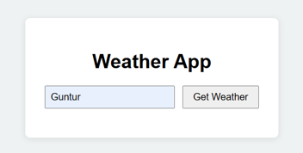
Output:

Slide 18
Thank you

